Slide 1


081100M01002H 图像处理与分析 第三讲: 数字图像的基本概念，图形变换 (I) 常用图像处理软件，图像的空间滤波，深度神经网络的基本概念
Lecture 3 September 19, 2019

Slide 2
第一讲：简要回顾
图像处理的基本概念 - 图像和视频包含的基本信息 - 可见光谱，光子能量的普朗克定律 - 图像处理的主要目的与不同层次 - 图像处理与计算机视觉的关系 - 图像处理在不同领域的应用和简要历史 - 图像处理系统的基本构成
人类视觉的基本机理
课程组织和相关信息 - 重要相关专业杂志和国际会议 - 重要网上资源和同类课程信息
MATLAB简介和学习资源

Slide 3
第二讲：简要回顾
图像格式的基本概念和常用类型 (TIFF, JPEG)
图像获取的基本概念 - 典型采集场景 - 典型成像设备 CCD vs CMOS
图像采样与量化 - 像素的位深度 (bit depth) - 空间采样，灰度采样 - 空间分辨率，灰度分辨率 - 图像的动态范围，饱和度和对比度
像素间的基本关系
图像插值
图像的基本数学运算，线性系统/线性算子的基本概念
图像的彩色模型

Slide 4
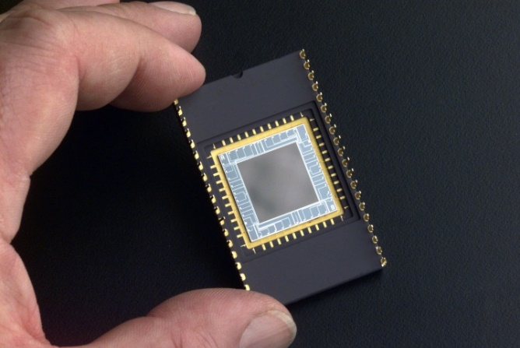
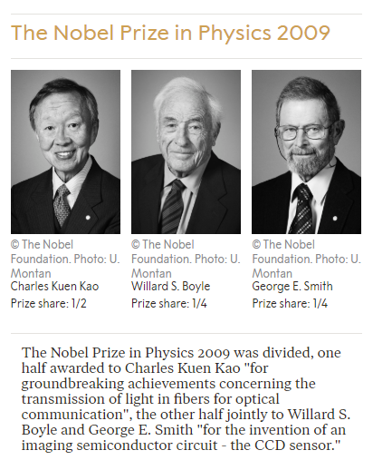
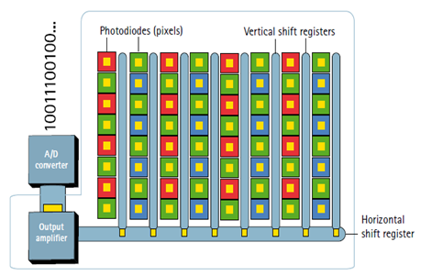
常用成像设备：CCD (电荷耦合器件）
http://micro.magnet.fsu.edu/primer/java/digitalimaging/ccd/interline/index.html

Slide 5
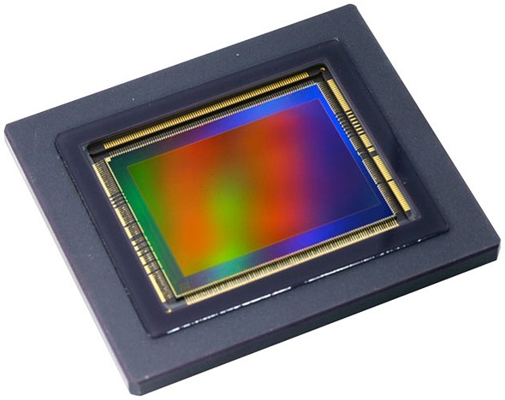
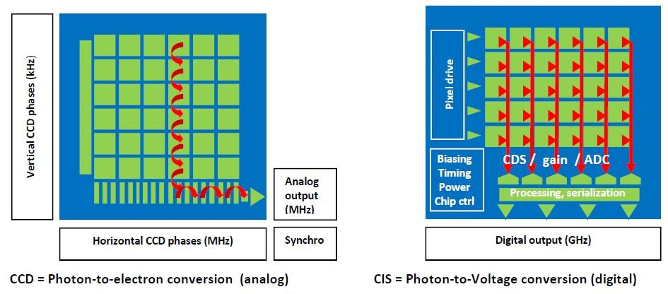
常用成像设备：CMOS (互补金属氧化物半导体)
https://www.azom.com/article.aspx?ArticleID=16321
https://www.dpreview.com/news/0671207908/canon-is-now-selling-cmos-image-sensors-including-a-120mp-aps-h-beast

Slide 6
关于第一次编程小作业
本周不安排编程小作业。下周布置第二次小作业。
- 提交作业评估 - 教学助理安排 - 答疑方式安排
第一次小作业的参考答案将在课程网站公布。
- 仅供参考，非唯一答案
作业发布和提交时间将移至上课次日，减少时间冲突。

Slide 7
内容提纲
图像处理的基本数学工具 (复习)
彩色图像模型与处理 (复习)
常用图像处理软件
图像的空间滤波
神经网络的基本概念
全连接神经网络
卷积神经网络的基本概念
点扩散函数的基本概念
Notes:
As you will see again and again in the class, to understand bioimage informatics depends critically on understanding the biological background of bioimage informatics. This is because bioimage informatics is created to answer biological questions rather than for technological curiosity. If we do not understand the biological questions, we will not be able to understand bioimage informatics. So for this reason we need to build some background knowledge about biology, and specifically for this lecture about cell biology.
For the most part of this course, our discussion on biology will be on a level that will be quite comfortable for you.
After that I will give you some historical perspectives and talk about where does it come from. Then I will discuss the learning objectives that we plan to achieve in this class. And finally I will go through the course syllabus together with you and discuss some details.

Slide 8
图像处理的基本数学工具 (复习)
彩色图像模型与处理 (复习)
常用图像处理软件
图像的空间滤波
神经网络的基本概念
全连接神经网络
卷积神经网络的基本概念
点扩散函数的基本概念
Notes:
As you will see again and again in the class, to understand bioimage informatics depends critically on understanding the biological background of bioimage informatics. This is because bioimage informatics is created to answer biological questions rather than for technological curiosity. If we do not understand the biological questions, we will not be able to understand bioimage informatics. So for this reason we need to build some background knowledge about biology, and specifically for this lecture about cell biology.
For the most part of this course, our discussion on biology will be on a level that will be quite comfortable for you.
After that I will give you some historical perspectives and talk about where does it come from. Then I will discuss the learning objectives that we plan to achieve in this class. And finally I will go through the course syllabus together with you and discuss some details.

Slide 9
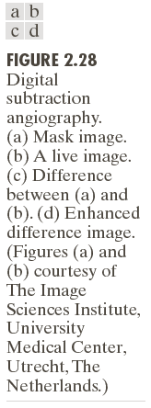
图像的简单算数运算 (I): 图像减法

Slide 10
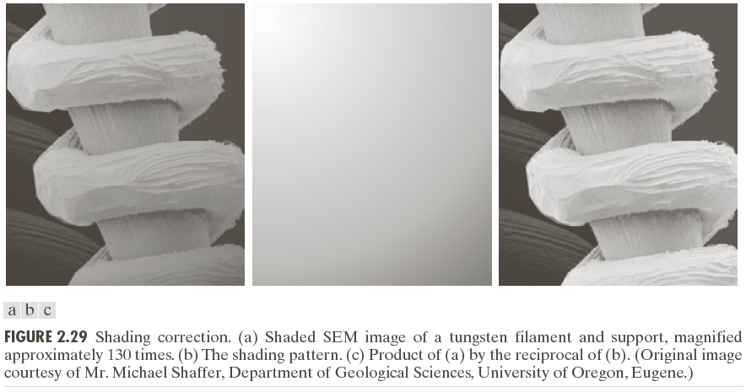
图像的简单算数运算 (II)：图像除法

Slide 11
图像的集合与逻辑运算示例 (I)

Slide 12
图像的集合与逻辑运算示例 (II)

Slide 13
图像的几何变换

Slide 14
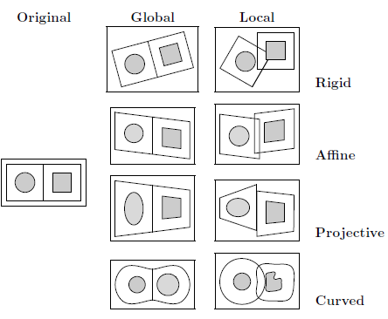
图像几何变换分类
变换类型 - 刚体（rigid） - 仿射 （affine） - 射影 （projective） - 分布式 （curved）
变换域 - 局部 - 全局

Slide 15
图像坐标变换 (I)
像素位置的齐次坐标表示
刚体变换

Slide 16
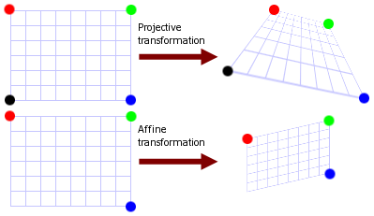
图像坐标变换 (II)
仿射变换和射影变换
仿射变换
射影变换
https://www.graphicsmill.com/docs/gm5/Transformations.htm

Slide 17
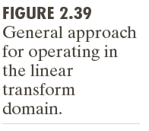
线性算子的基本概念

Slide 18
图像处理的基本数学工具 (复习)
彩色图像模型与处理 (复习)
常用图像处理软件
图像的空间滤波
神经网络的基本概念
全连接神经网络
卷积神经网络的基本概念
点扩散函数的基本概念
Notes:
As you will see again and again in the class, to understand bioimage informatics depends critically on understanding the biological background of bioimage informatics. This is because bioimage informatics is created to answer biological questions rather than for technological curiosity. If we do not understand the biological questions, we will not be able to understand bioimage informatics. So for this reason we need to build some background knowledge about biology, and specifically for this lecture about cell biology.
For the most part of this course, our discussion on biology will be on a level that will be quite comfortable for you.
After that I will give you some historical perspectives and talk about where does it come from. Then I will discuss the learning objectives that we plan to achieve in this class. And finally I will go through the course syllabus together with you and discuss some details.

Slide 19
色彩的基本概念 (I)

Slide 20
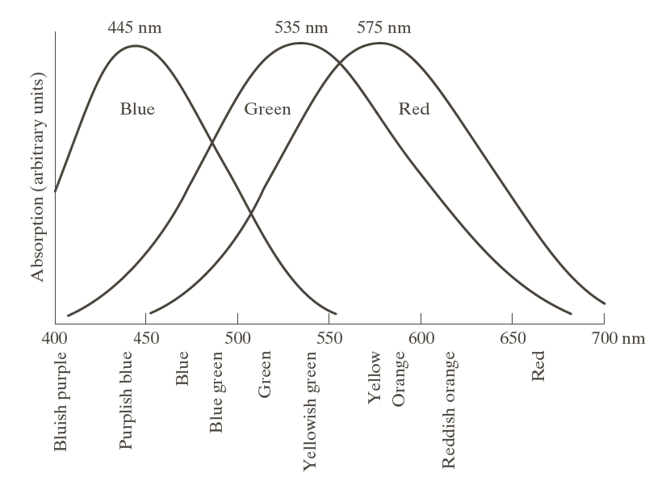
色彩的基本概念 (II)
人类的锥状感光细胞中65%对于红色敏感，33%对于绿色敏感，只有2%对于蓝色敏感。
国际照明委员会定义 蓝 = 435.8 nm 绿 = 546.1 nm 红 = 700 nm

Slide 21
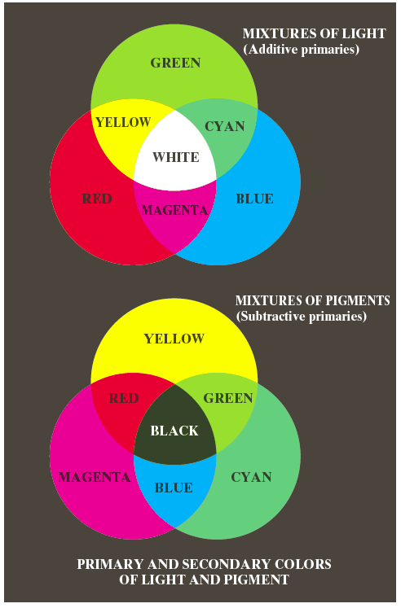
不同颜色的组合
光的(加性)原色与二次色
颜料的(减性)原色与二次色
三色值系数 x = X/(X+Y+Z) y = Y/(X+Y+Z) z = Z/(X+Y+Z)
https://www.printplace.com/blog/reasons-for-cmyk-printing/

Slide 22
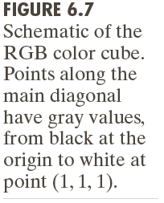
彩色模型(I): RGB模型-加性模型
(2⁸)³ = 16,777,216

Slide 23

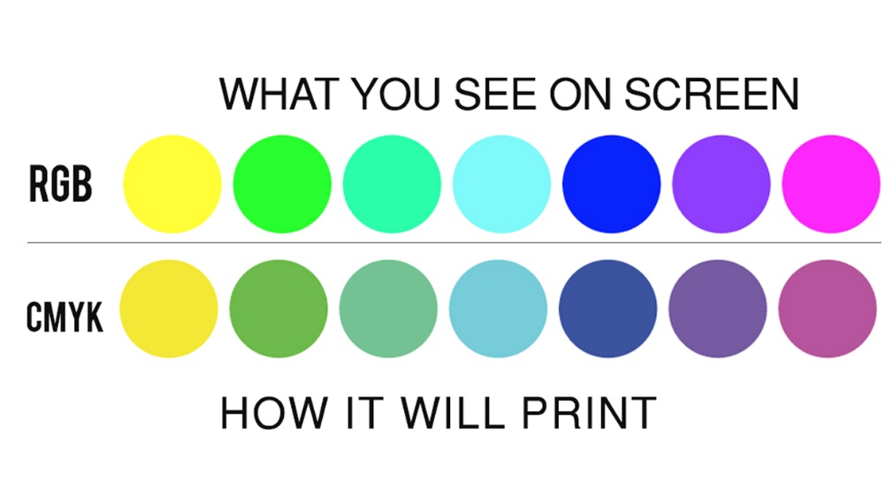
彩色模型(II): CMYK模型-减性模型
CMYK 模型更适合打印和印刷。
相对于RGB, CMYK更容易实现浅色。
https://www.printplace.com/blog/reasons-for-cmyk-printing/

Slide 24
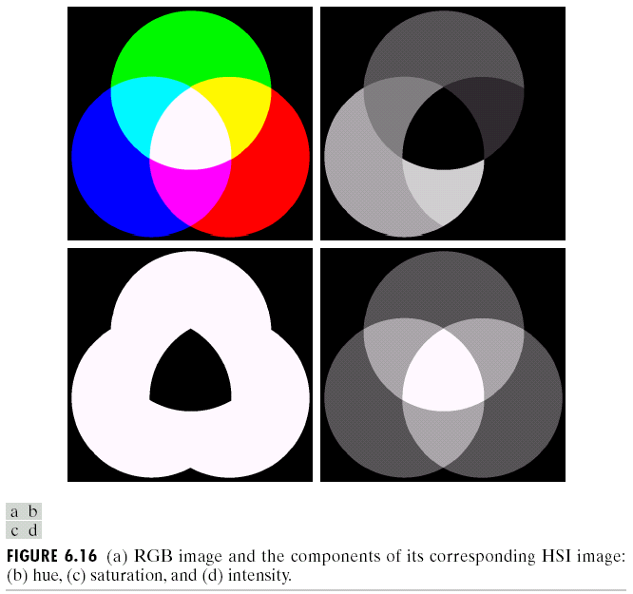
HSI/HSL/HSV彩色模型
H: 色调 - 纯度
S: 饱和度 - 白色的稀释度
I: 强度 (intensity)
L: 亮度 (lightness)
V: 亮度 (value)

Slide 25
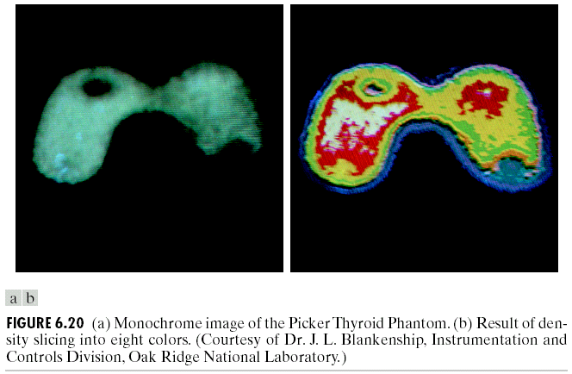
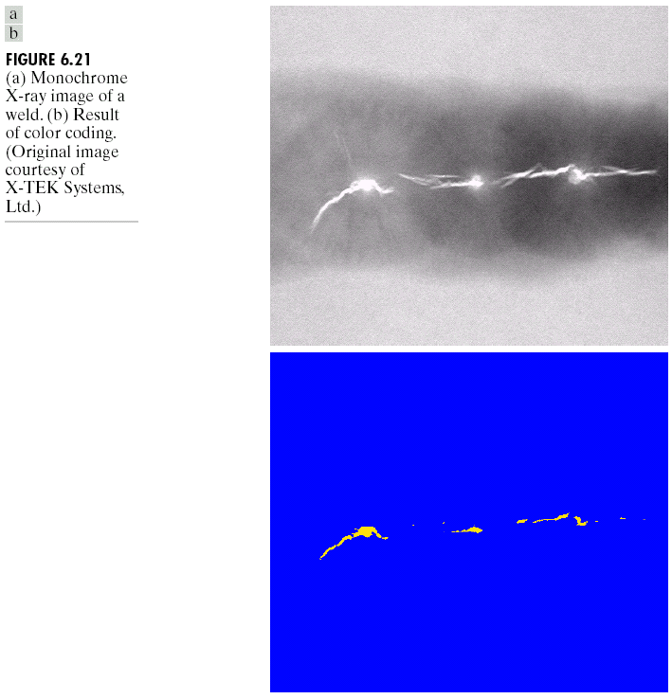
灰度图像转换为伪彩色图像 (I)

Slide 26
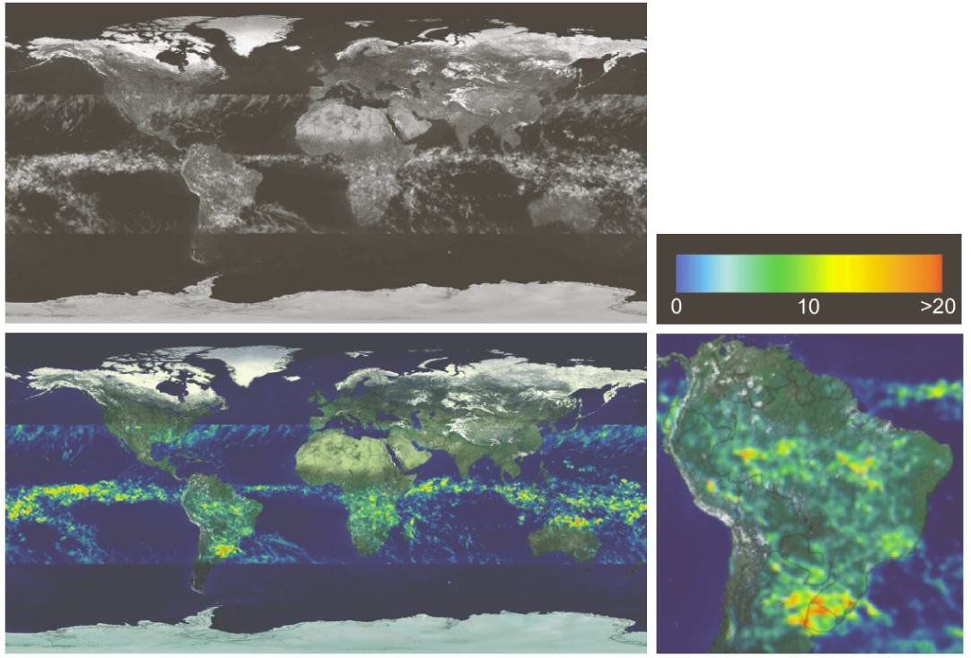
灰度图像转换为伪彩色图像 (II)

Slide 27
伪彩色多通道图像

Slide 28
彩色图像变换

Slide 29
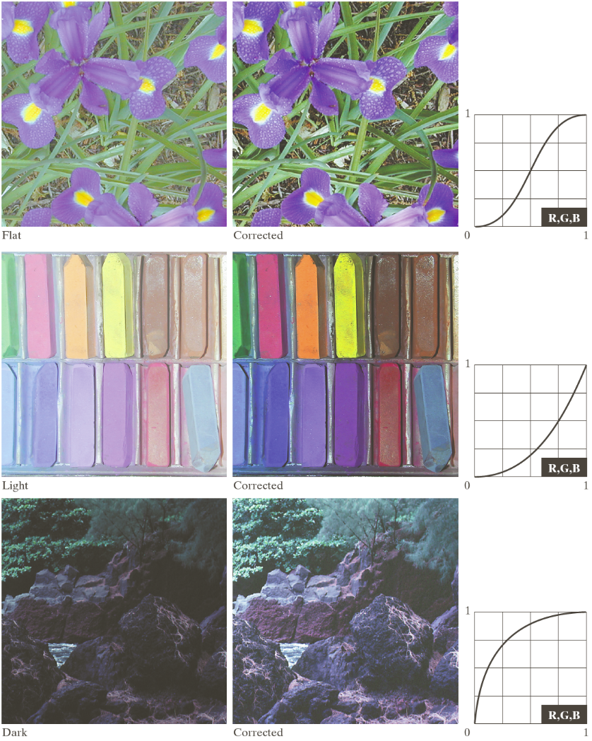
彩色图像色调校正

Slide 30
彩色图像处理示例 (I)

Slide 31
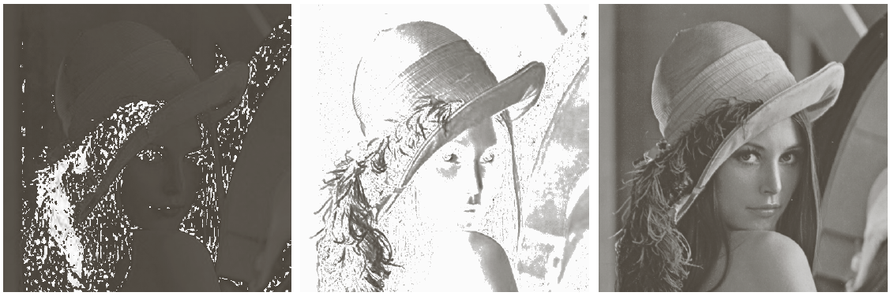
彩色图像处理示例 (II)

Slide 32
彩色图像处理示例 (III)

Slide 33
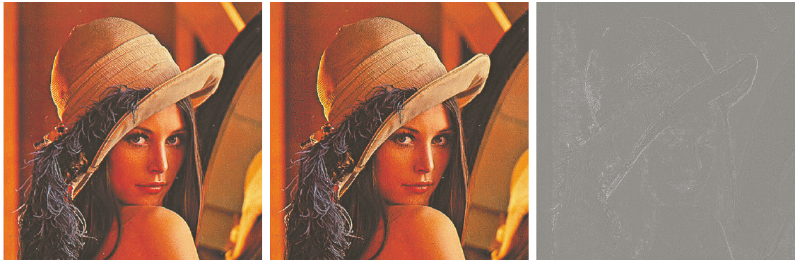
彩色图像处理示例 (IV)

Slide 34
图像处理的基本数学工具 (复习)
彩色图像模型与处理 (复习)
常用图像处理软件
图像的空间滤波
神经网络的基本概念
全连接神经网络
卷积神经网络的基本概念
点扩散函数的基本概念
Notes:
As you will see again and again in the class, to understand bioimage informatics depends critically on understanding the biological background of bioimage informatics. This is because bioimage informatics is created to answer biological questions rather than for technological curiosity. If we do not understand the biological questions, we will not be able to understand bioimage informatics. So for this reason we need to build some background knowledge about biology, and specifically for this lecture about cell biology.
For the most part of this course, our discussion on biology will be on a level that will be quite comfortable for you.
After that I will give you some historical perspectives and talk about where does it come from. Then I will discuss the learning objectives that we plan to achieve in this class. And finally I will go through the course syllabus together with you and discuss some details.

Slide 35
基本图像处理工具简介：Adobe Photoshop (I)
主要用于光栅(raster)图像(像素图像)编辑，图形设计和数字美术。
主要使用图像层 (layering) 来实现设计与编辑的功能。
于1988年由Thomas & John Knoll兄弟首创，1989年出售给Adobe，目前已成为事实上的工业标准。
Adobe Photoshop 1.0 于1990年2月19日开始发售。
主要格式是 .PSD (photoshop document). 支持30,000×30,000像素的图像，文件最大2GB。

Slide 36
基本图像处理工具简介：Adobe Photoshop (II)
大文件格式 .PSB (Photoshop Big) 支持300,000×300,000像素图像，文件大小上限为 4 Exabyte (4百万TB）。
支持多种彩色模型 （RGB, CMYK, CIELAB, Duotone, LAB)
主要功能 - 像素编辑 - 图像校正
- 图像滤波 - 三维设计 - 简单视频编辑

Slide 37
基本图像处理工具简介：Adobe Photoshop (III)
易用性较好但编程功能有限。
常用功能 - 图像格式转换 - 图像文件大小调整 - 图像亮度，对比度，色彩调整 - 基本图像处理 （滤镜功能） - 排版图设计 - 图像打印

Slide 38
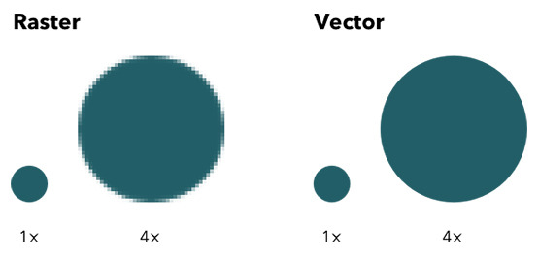
基本图像处理工具简介：Adobe Illustrator
用于矢量图设计，包括高端科技出版图形设计与排版。出版业常采用。
可通过便利的图形缩放，颜色修改等等。
可使用EPS图形格式。
复杂几何造型功能有限。
于1987年1月开始发售。

Slide 39

基本图像处理工具简介：OpenCV (I)
早期主要由Intel支持，第一版于2000年6月CVPR首发。
主要编程语言是C++，提供已优化代码。
正式版1.0于2006年发布。
OpenCV2 于2009年10月分布。
2012年8月成立OpenCV.org。

Slide 40
基本图像处理工具简介：OpenCV (II)
提供基本图像处理功能
目前包括超过2500 个优化计算机视觉算法。
主要功能 - 物体识别 - 跟踪 - 物体几何重建
支持Python, Java 和MATLAB接口。
支持深度学习框架 TensorFlow, Torch/PyTorch.

Slide 41
基本图像处理工具简介：MATLAB 图像处理工具箱
基本输入输出，格式转换，显示，主要针对单幅图像
图像的几何变换
线性滤波
图像形态学处理
图像增强
图像分割
图像去模糊
彩色图像处理
大图像处理

Slide 42
基本图像处理工具简介：MATLAB 计算机视觉工具箱
基本输入输出，格式转换，显示，主要针对视频文件
提供与OpenCV的接口
图像配准和立体视觉
物体识别
运动估计与跟踪
图像的几何变换
图像滤波和增强
图像的统计学和形态学处理
代码生成

Slide 43
基本图像处理工具简介：PIL/Pillow
PIL- Python Imaging Library http://www.pythonware.com/products/pil/ - 基本图像操作 - 图像增强，滤波
最早起始于1995年
最后一个稳定版是 PIL1.1.7, 发布于2009年11月
Pillow在PIL基础上开发，提供对于Python 3.x 版的支持。

Slide 44

基本图像处理工具简介：IDL
早期开发起始于1970年代。
在几个专业领域有广泛使用。 - 天文学 - 地理信息 - 大气物理 - 医学影像
交互式语言，支持矢量处理和数值分析。

Slide 45
图像处理的基本数学工具 (复习)
彩色图像模型与处理 (复习)
常用图像处理软件
图像的空间滤波
神经网络的基本概念
全连接神经网络
卷积神经网络的基本概念
点扩散函数的基本概念
Notes:
As you will see again and again in the class, to understand bioimage informatics depends critically on understanding the biological background of bioimage informatics. This is because bioimage informatics is created to answer biological questions rather than for technological curiosity. If we do not understand the biological questions, we will not be able to understand bioimage informatics. So for this reason we need to build some background knowledge about biology, and specifically for this lecture about cell biology.
For the most part of this course, our discussion on biology will be on a level that will be quite comfortable for you.
After that I will give you some historical perspectives and talk about where does it come from. Then I will discuss the learning objectives that we plan to achieve in this class. And finally I will go through the course syllabus together with you and discuss some details.

Slide 46
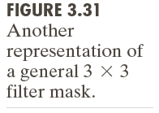
一个简单例子：均值滤波

Slide 47
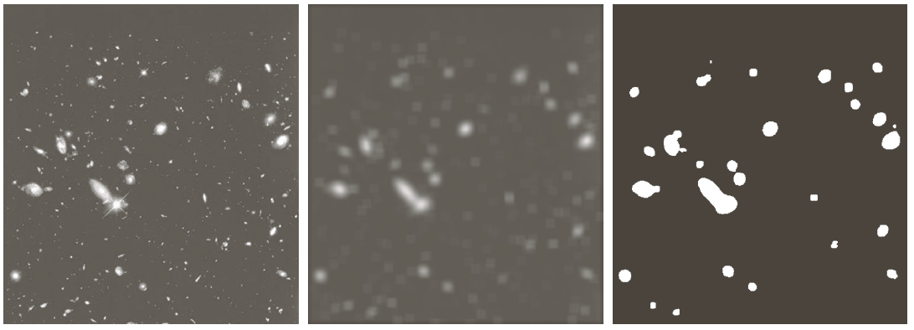
均值滤波的一个实际应用

Slide 48
均值滤波的一个改进：中值滤波
中值滤波是一种非线性滤波
证明非线性的一个反例

Slide 49
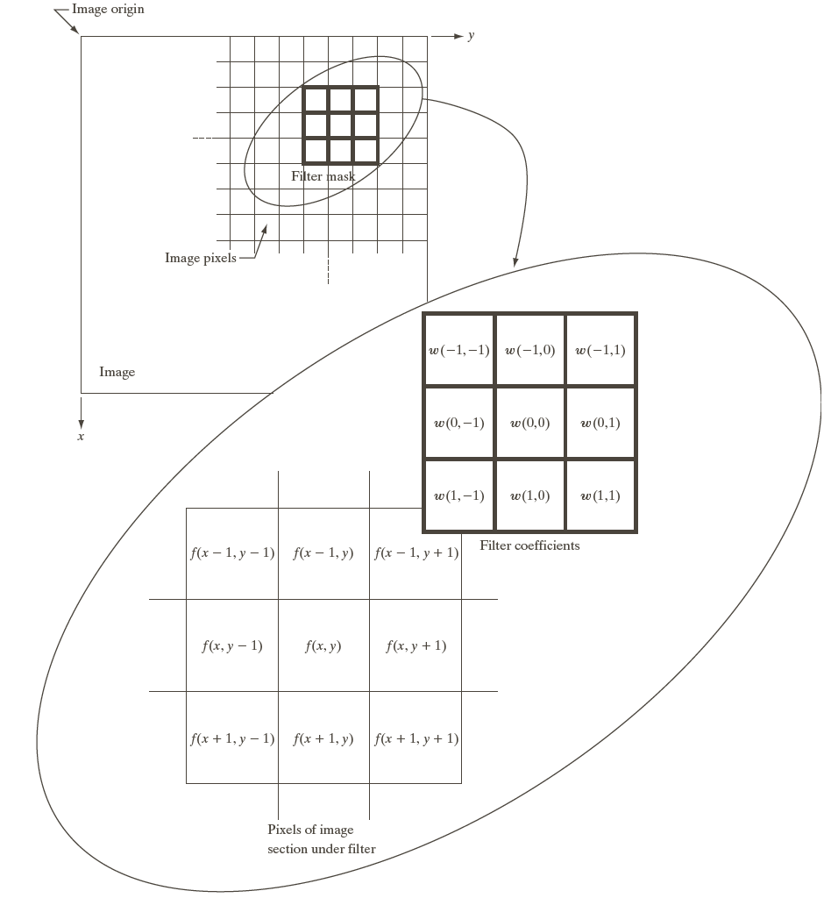
图像的空间滤波：基本概念
空间滤波器(核)
相关函数
Correlation between w() and f()
卷积函数
Convolution between w() and f()

Slide 50
一维信号空间相关与卷积示例

Slide 51
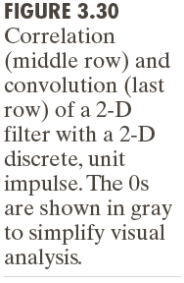
二维信号空间相关与卷积示例

Slide 52
计算图像的一阶和二阶导数

Slide 53
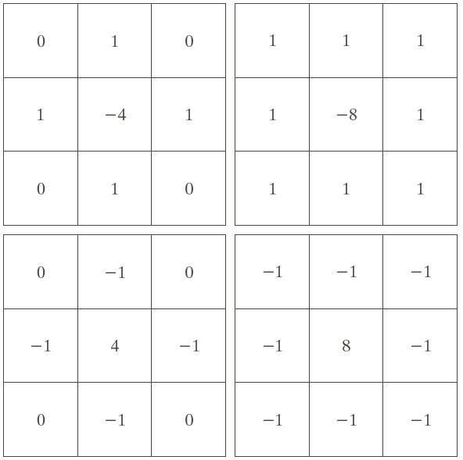
图像的空间滤波：拉普拉斯算子

Slide 54
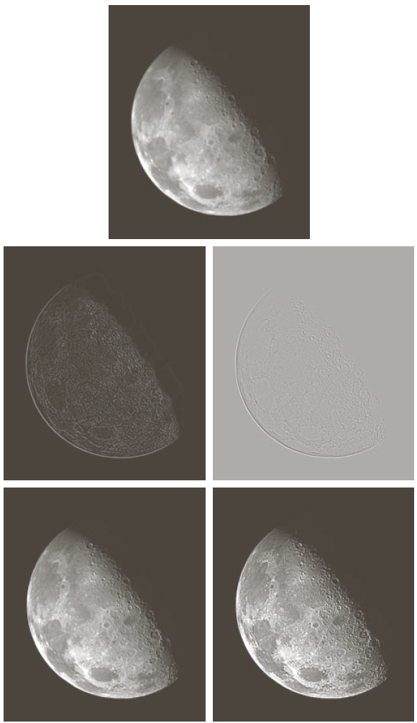
拉普拉斯算子应用：图像的锐化处理

Slide 55
图像处理的基本数学工具 (复习)
彩色图像模型与处理 (复习)
常用图像处理软件
图像的空间滤波
神经网络的基本概念
全连接神经网络
卷积神经网络的基本概念
点扩散函数的基本概念
Notes:
As you will see again and again in the class, to understand bioimage informatics depends critically on understanding the biological background of bioimage informatics. This is because bioimage informatics is created to answer biological questions rather than for technological curiosity. If we do not understand the biological questions, we will not be able to understand bioimage informatics. So for this reason we need to build some background knowledge about biology, and specifically for this lecture about cell biology.
For the most part of this course, our discussion on biology will be on a level that will be quite comfortable for you.
After that I will give you some historical perspectives and talk about where does it come from. Then I will discuss the learning objectives that we plan to achieve in this class. And finally I will go through the course syllabus together with you and discuss some details.

Slide 56
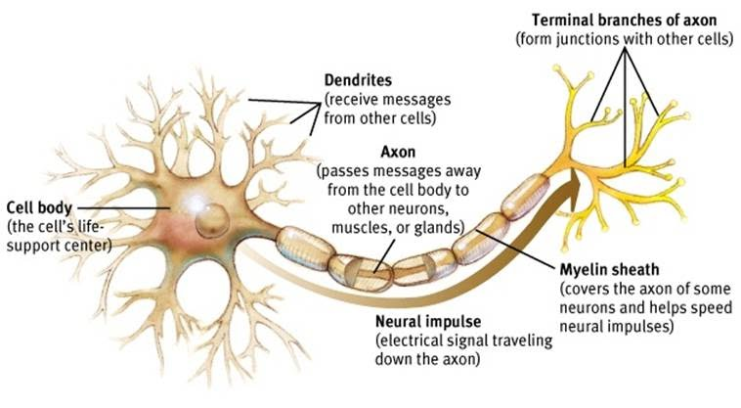
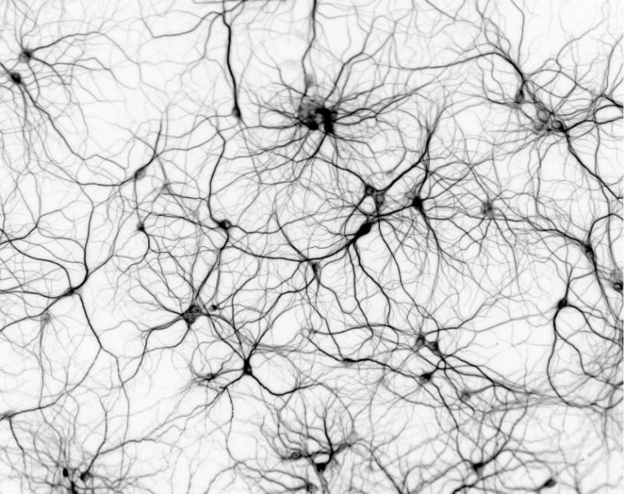
生物神经网络
https://sites.google.com/site/mrstevensonstechclassroom/hl-topics-only/4a-robotics-ai/neural-networks-computational-intelligence

Slide 57
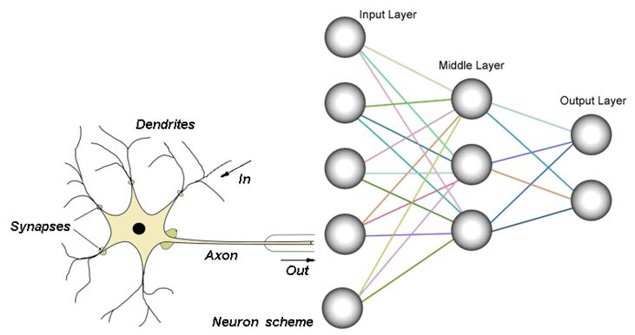
生物与人工神经网络的比较
https://sites.google.com/site/mrstevensonstechclassroom/hl-topics-only/4a-robotics-ai/neural-networks-computational-intelligence

Slide 58
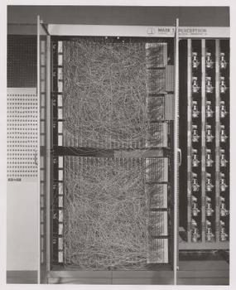
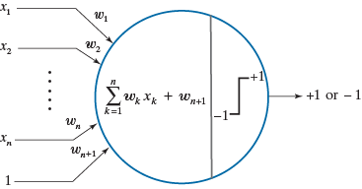
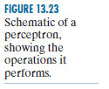
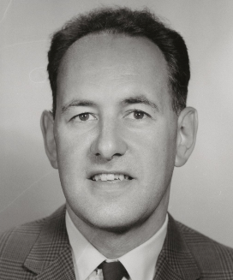
感知机-Perceptron (1958)
Frank Rosenblatt

Slide 59
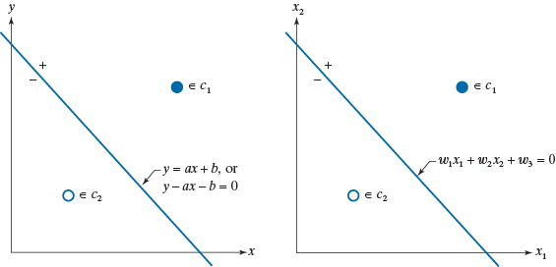
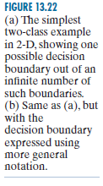
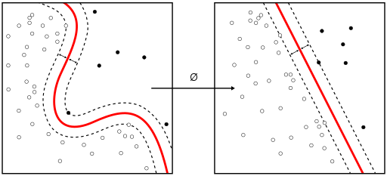
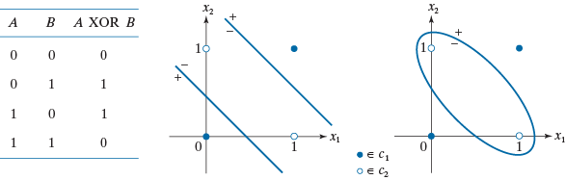
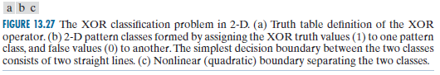
感知机用于分类两个线性可分模式

Slide 60
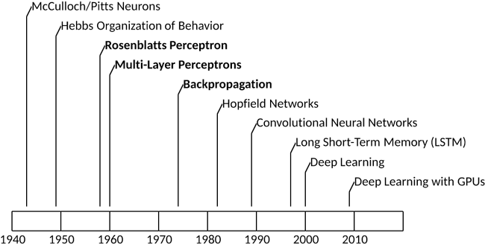
神经网络研究简史 (I)
https://developer.ibm.com/articles/cc-cognitive-neural-networks-deep-dive/

Slide 61
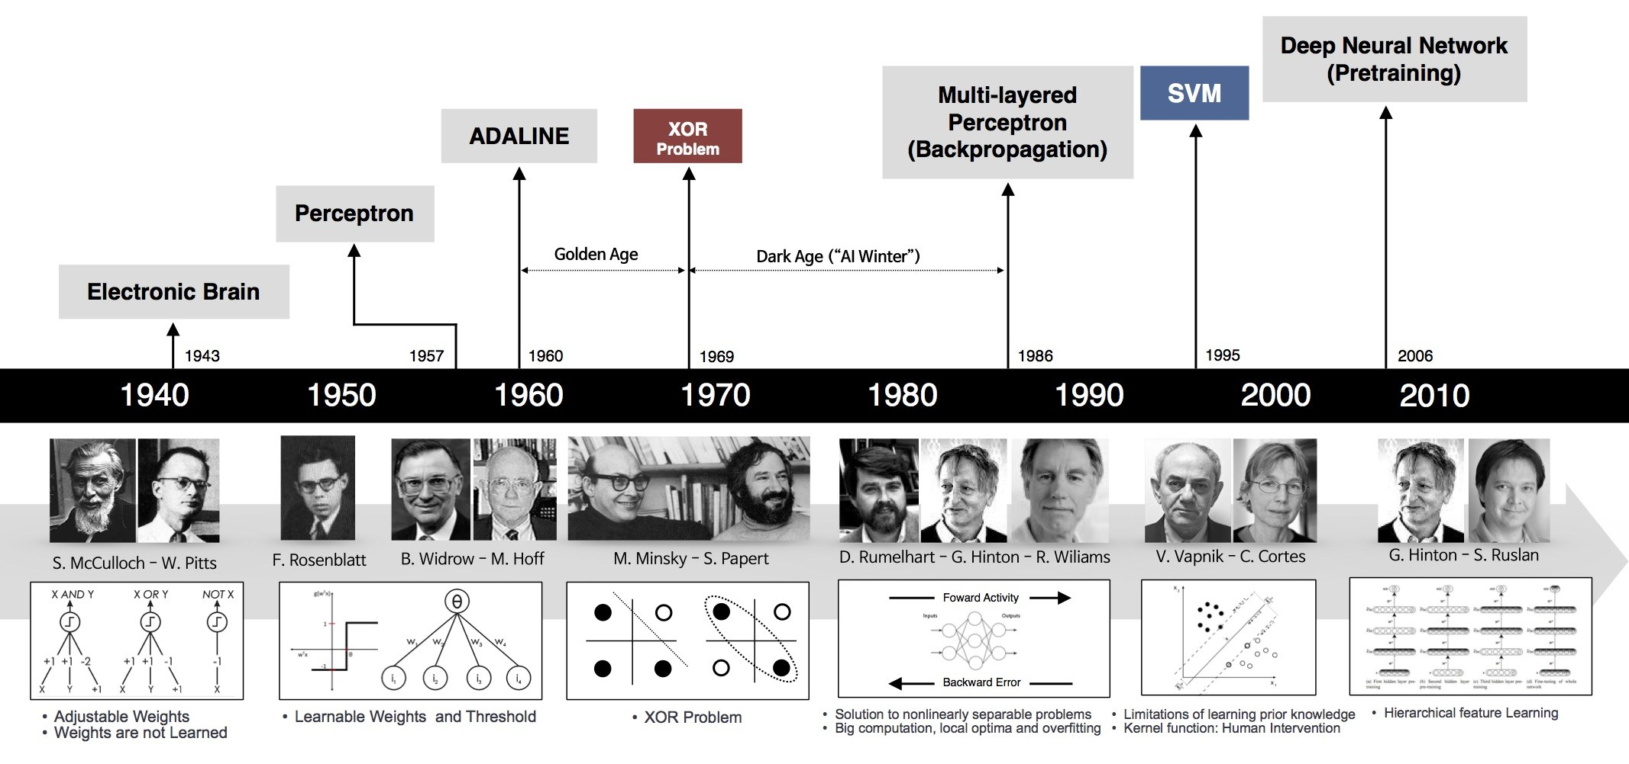
神经网络研究简史 (II)
https://sefiks.com/2017/10/14/evolution-of-neural-networks/

Slide 62
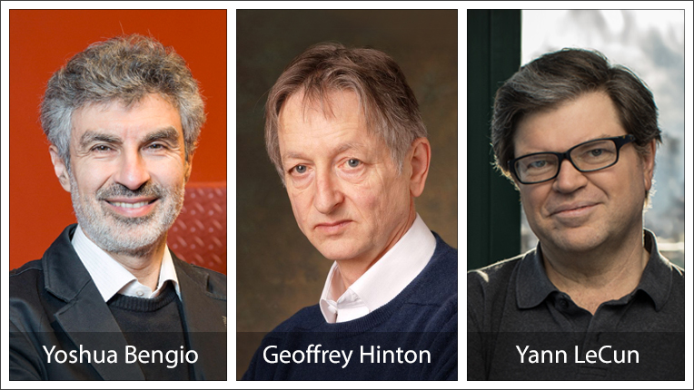
深度神经网络先驱获得2019年图灵奖
https://www.acm.org/media-center/2019/march/turing-award-2018

Slide 63
图像处理的基本数学工具 (复习)
彩色图像模型与处理 (复习)
常用图像处理软件
图像的空间滤波
神经网络的基本概念
全连接神经网络
卷积神经网络的基本概念
点扩散函数的基本概念
Notes:
As you will see again and again in the class, to understand bioimage informatics depends critically on understanding the biological background of bioimage informatics. This is because bioimage informatics is created to answer biological questions rather than for technological curiosity. If we do not understand the biological questions, we will not be able to understand bioimage informatics. So for this reason we need to build some background knowledge about biology, and specifically for this lecture about cell biology.
For the most part of this course, our discussion on biology will be on a level that will be quite comfortable for you.
After that I will give you some historical perspectives and talk about where does it come from. Then I will discuss the learning objectives that we plan to achieve in this class. And finally I will go through the course syllabus together with you and discuss some details.

Slide 64
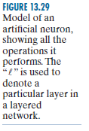
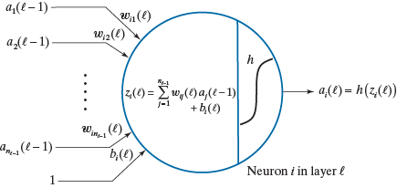
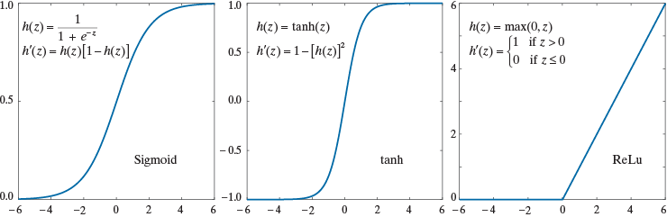
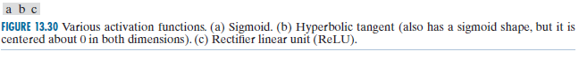
一个人工神经元模型

Slide 65
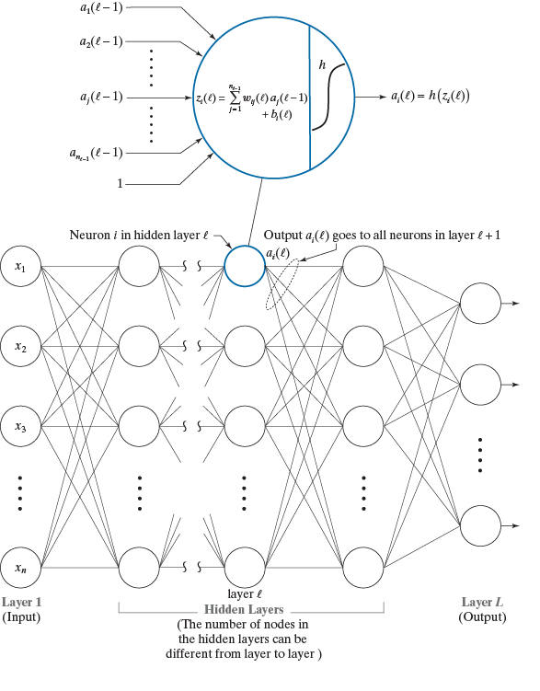
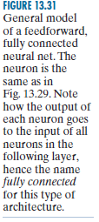
全连接前馈人工神经网络

Slide 66
通用近似理论
A feedforward network with a single hidden layer containing a finite number of neurons can approximate continuous functions on compact subset of R^{m} under mild assumption of the activation function.
Kurt Hornik (1991) "Approximation Capabilities of Multilayer Feedforward Networks", Neural Networks, 4(2), 251–257.

Slide 67
基于反向传播的神经网络的训练
LeCun et al, Nature, 2015

Slide 68
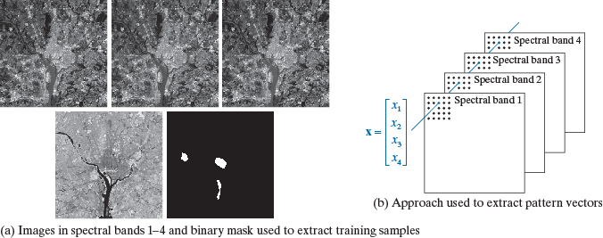
Application I: Image Classification
Gonzalez & Woods, DIP, 4/e, 2018

Slide 69
Application II: HEp-2 Cells Classification
Foggia et al, Benchmarking HEp-2 cells classification methods, IEEE Trans Med Imaging, 2013.

Slide 70
Application II: Hep-2 Cells Classification
Performance of classification depends on feature design/selection
Foggia et al, Benchmarking HEp-2 cells classification methods, IEEE Trans Med Imaging, 2013.

Slide 71
图像处理的基本数学工具 (复习)
彩色图像模型与处理 (复习)
常用图像处理软件
图像的空间滤波
神经网络的基本概念
全连接神经网络
卷积神经网络的基本概念
点扩散函数的基本概念
Notes:
As you will see again and again in the class, to understand bioimage informatics depends critically on understanding the biological background of bioimage informatics. This is because bioimage informatics is created to answer biological questions rather than for technological curiosity. If we do not understand the biological questions, we will not be able to understand bioimage informatics. So for this reason we need to build some background knowledge about biology, and specifically for this lecture about cell biology.
For the most part of this course, our discussion on biology will be on a level that will be quite comfortable for you.
After that I will give you some historical perspectives and talk about where does it come from. Then I will discuss the learning objectives that we plan to achieve in this class. And finally I will go through the course syllabus together with you and discuss some details.

Slide 72



Concept of Receptive Field
https://www.cns.nyu.edu/~david/courses/perception/lecturenotes/ganglion/ganglion.html

Slide 73

A CNN Containing Basic Elements of a LeNet
http://yann.lecun.com/exdb/lenet/
Y. LeCun, L. Bottou, Y. Bengio, and P. Haffner. Gradient-based learning applied to document recognition.Proceedings of the IEEE, november 1998.

Slide 74


CNN success story: ILSVRC 2012
ILSVRC: ImageNet Large Scale Visual Recognition Challenge
ImageNet database: 14 million labeled images, 20K categories
http://www.image-net.org/challenges/LSVRC/

Slide 75
ILSVRC: Classification

Slide 76
The AlexNet

Slide 77
ImagenNet Classifications 2012

Slide 78
ILSVRC 2012: Top Rankers
http://www.image-net.org/challenges/LSVRC/2012/results.html
N | Error-5 | Algorithm | Team | Authors
1 | 0.153 | Deep Conv. Neural Network | Univ. of Toronto | Krizhevsky et al
2 | 0.262 | Features + Fisher Vectors + Linear classifier | ISI | Gunji et al
3 | 0.270 | Features + FV + SVM | OXFORD_VGG | Simonyan et al
4 | 0.271 | SIFT + FV + PQ + SVM | XRCE/INRIA | Perronin et al
5 | 0.300 | Color desc. + SVM | Univ. of Amsterdam | van de Sande et al

Slide 79
Imagenet 2013: Top Rankers
http://www.image-net.org/challenges/LSVRC/2013/results.php
N | Error-5 | Algorithm | Team | Authors
1 | 0.117 | Deep Convolutional Neural Network | Clarifi | Zeiler
2 | 0.129 | Deep Convolutional Neural Networks | Nat.Univ Singapore | Min LIN
3 | 0.135 | Deep Convolutional Neural Networks | NYU | Zeiler Fergus
4 | 0.135 | Deep Convolutional Neural Networks |  | Andrew Howard
5 | 0.137 | Deep Convolutional Neural Networks | Overfeat NYU | Pierre Sermanet et al

Slide 80

Top-5 Error Rates 2010-2015
https://devblogs.nvidia.com/mocha-jl-deep-learning-julia/image1/

Slide 81
图像处理的基本数学工具 (复习)
彩色图像模型与处理 (复习)
常用图像处理软件
图像的空间滤波
神经网络的基本概念
全连接神经网络
卷积神经网络的基本概念
点扩散函数的基本概念
Notes:
As you will see again and again in the class, to understand bioimage informatics depends critically on understanding the biological background of bioimage informatics. This is because bioimage informatics is created to answer biological questions rather than for technological curiosity. If we do not understand the biological questions, we will not be able to understand bioimage informatics. So for this reason we need to build some background knowledge about biology, and specifically for this lecture about cell biology.
For the most part of this course, our discussion on biology will be on a level that will be quite comfortable for you.
After that I will give you some historical perspectives and talk about where does it come from. Then I will discuss the learning objectives that we plan to achieve in this class. And finally I will go through the course syllabus together with you and discuss some details.

Slide 82


A Microscope as a Linear System
A light microscope can be considered as a linear system.
A linear system satisfies the following two conditions
- Homogeneity
- Additivity
Homogeneity
Additivity

Slide 83
How to Characterize a Linear System
A linear system can be characterized by
- Impulse response
- Frequency response
Impulse response of a microscope: point spread function
Frequency response of a microscope: optical transfer function

Slide 84

Airy Disk
Airy (after George Biddell Airy) disk is the diffraction pattern of a point feature under a circular aperture.
It has the following form
Detailed derivation is given in Born & Wolf, Principles of Optics, 7th ed., pp. 439-441.
J₁(x) is a Bessel function of the first kind.

Slide 85

Microscope Image Formation (I)
Microscope image formation can be modeled as a convolution with the PSF.
http://micro.magnet.fsu.edu/primer/java/mtf/airydisksize/index.html

Slide 86
Microscope Image Formation (II)
The impulse response of the microscope is called its point spread function (PSF).
The transfer function of a microscope is called its optical transfer function (OTF).
The PSF has the shape of an Airy Disk.

Slide 87

Numerical Aperture
Numerical aperture (NA) determines microscope resolution and light collection power.
n: refractive index of the medium between the lens and the specimen
μ: half of the angular aperture

Slide 88

Different Definition of Light Microscopy Resolution Limit (Demo)
Rayleigh limit
Sparrow limit
http://www.microscopy.fsu.edu/primer/java/imageformation/rayleighdisks/index.html

Slide 89
Summary: High Resolution Microscopy
Size of cellular features are typically on the scale of a micron or smaller.
To resolve such features require
- Shorter wavelength (electron microscopy) - High numerical aperture (resolution) - High magnification (spatial sampling)

Slide 90
Questions?

